Slide 1
EECE 5644 Machine Learning
Alexander Montes McNiel
Nishanth Marer Prabhu

Slide 2
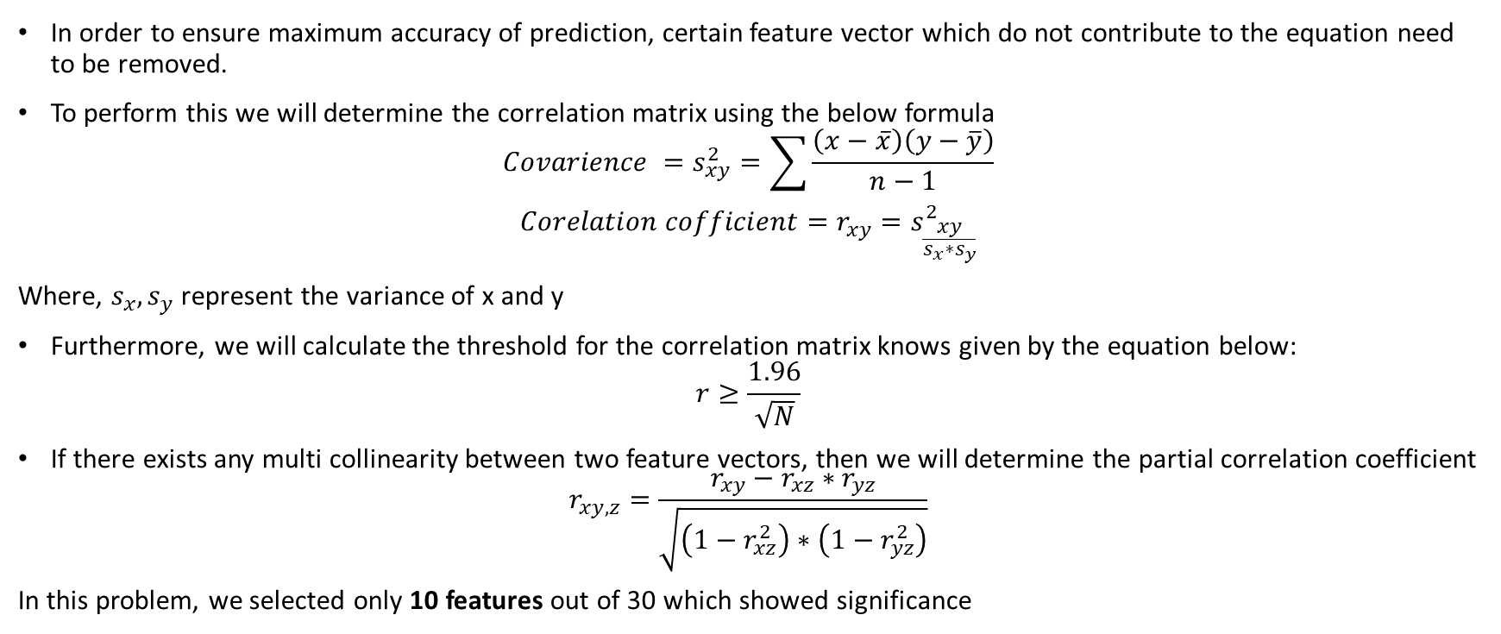
Data Pre-processing
In order to ensure maximum accuracy of prediction, certain feature vector which do not contribute to the equation need to be removed.
To perform this we will determine the correlation matrix using the below formula
$$Covarience =s_{xy}^{2}=\sum{\frac{\left(x−\overline{x}\right)\left(y−\overline{y}\right)}{n−1}}$$
$$Corelation cofficient=r_{xy}=s_{\frac{xy}{s_{x}∗s_{y}}}^{2}$$
Where, $s_{x}, s_{y}$ represent the variance of x and y
Furthermore, we will calculate the threshold for the correlation matrix knows given by the equation below:
$$r≥\frac{1.96}{\sqrt{N}}$$
If there exists any multi collinearity between two feature vectors, then we will determine the partial correlation coefficient
$$r_{xy,z}=\frac{r_{xy}−r_{xz}∗r_{yz}}{\sqrt{\left(1−r_{xz}^{2}\right)∗\left(1−r_{yz}^{2}\right)}}$$
In this problem, we selected only 10 features out of 30 which showed significance

Slide 3
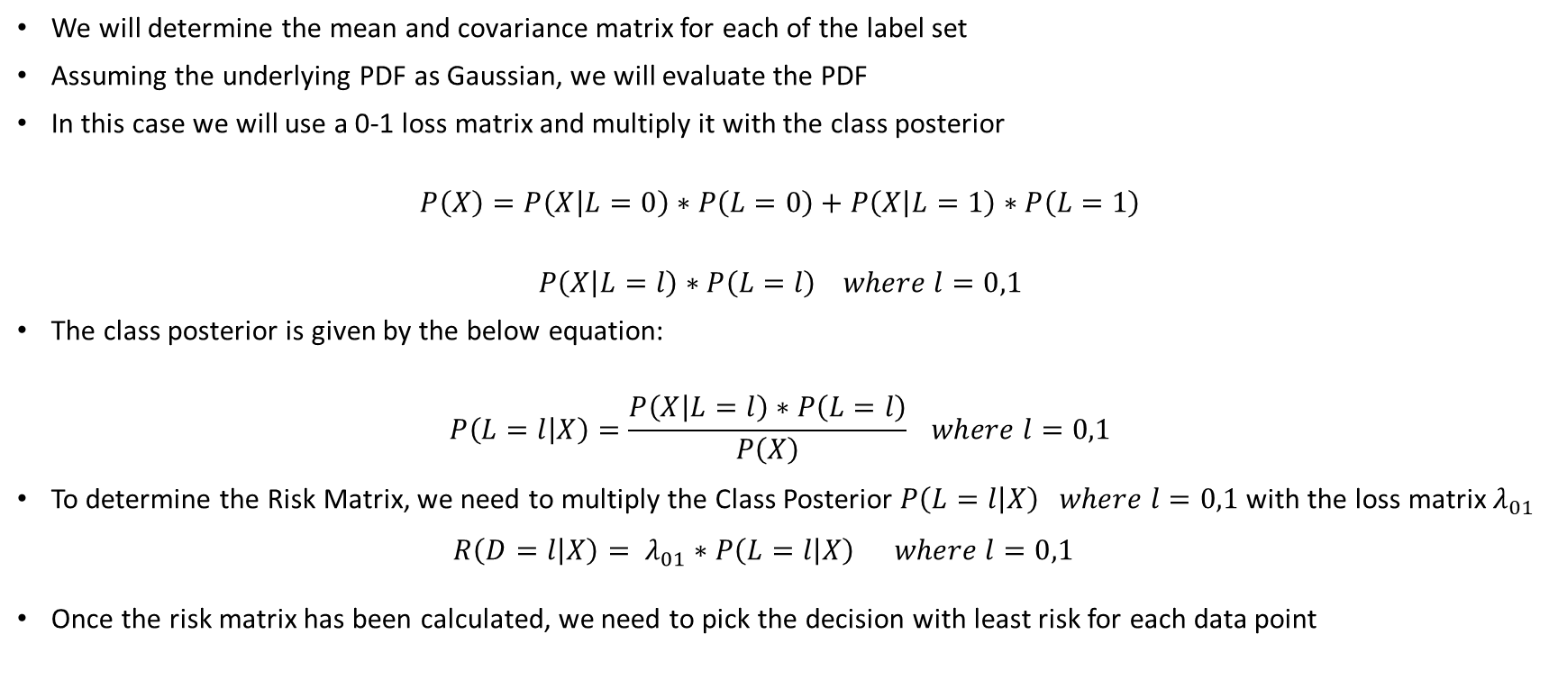
Expected Risk Minimization (ERM)
We will determine the mean and covariance matrix for each of the label set
Assuming the underlying PDF as Gaussian, we will evaluate the PDF
In this case we will use a 0-1 loss matrix and multiply it with the class posterior
$$P\left(X\right)=P\left(X | L=0\right)∗P\left(L=0\right)+P\left(X | L=1\right)∗P\left(L=1\right)$$
$$P\left(X | L=l\right)∗P\left(L=l\right) where l=0,1$$
The class posterior is given by the below equation:
$$P\left(L=l | X\right)=\frac{P\left(X | L=l\right)∗P\left(L=l\right)}{P\left(X\right)} where l=0,1$$
To determine the Risk Matrix, we need to multiply the Class Posterior $P\left(L=l | X\right) where l=0,1$with the loss matrix $λ_{01}$
$$R\left(D=l | X\right)= λ_{01}∗P\left(L=l | X\right) where l=0,1$$
Once the risk matrix has been calculated, we need to pick the decision with least risk for each data point

Slide 4
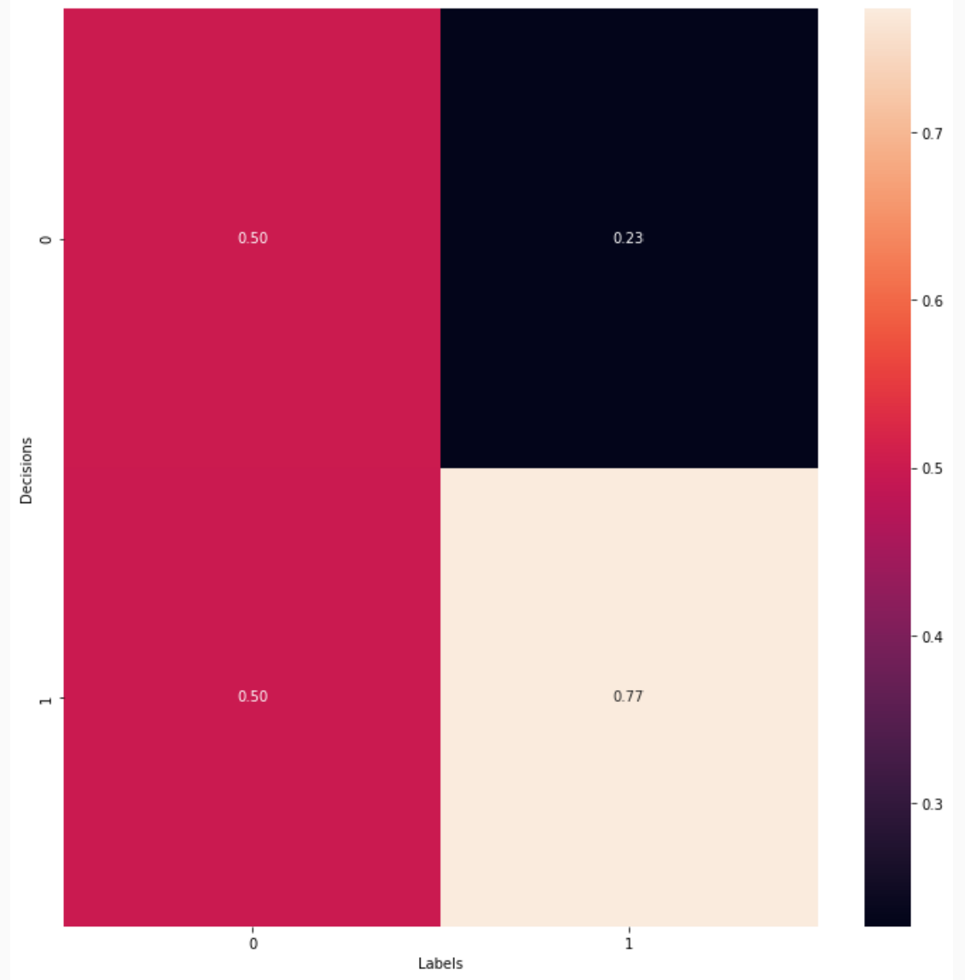
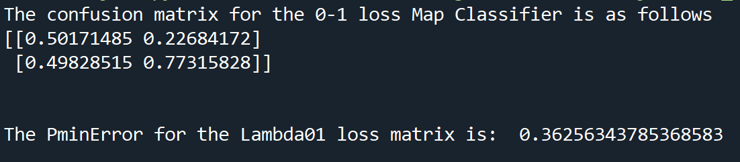
Results for ERM
The confusion matrix and the PminError is as follows:

